Slide 1

PHP Web
Course Introduction
SoftUni Team
Technical Trainers
Software University
http://softuni.bg

Slide 2
Table of Contents
Course Objectives
Training and Team
Course Organization
Course Infrastructure
Evaluation Criteria

Slide 3
Have a Question?
sli.do
#php-web

Slide 4

Course Objectives

Slide 5
Php Web Basic Course Goals
Basic knowledge over HTML and CSS
Fundamental knowledge over what is HTTP and how it works
Creating and using classes and objects, abstraction, polymorphism, inheritance, encapsulation
Fundamental knowledge over what is a database and how it works
Fundamental knowledge for creating web applications

Slide 6
Practical Exam
Practical exam for 6 hours
Creating a database using SQL
Creating CRUD Application using the learned syntax, technologies and database
Solutions are evaluated for each participant by hand

Slide 7

The Team

Slide 8
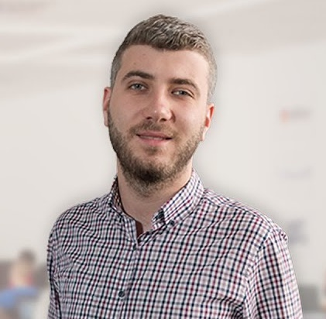
Ivan Yonkov
CEO @ Codexio
Former CTO @ LockTrip
Former Training Director @ SoftUni
5+ years developer experience
3+ years QA experience
4+ years of being Technical Trainer @ SoftUni

Slide 9
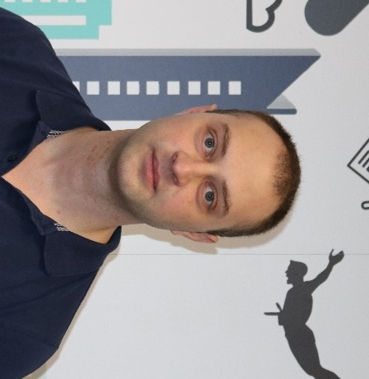
Mihail Velikov
Program Lead and Trainer @ SoftUni
Interested in:
Java
C#
JavaScript
PHP

Slide 10

Course Organization

Slide 11
Php Web Basic Module – Timeline
13-May-2019
8-July-2018
PHP Web Development Basic
8 weeks * 4 times / week
9 credits
Start: 13-May-2019
Final exam: 7-July-2019
PHP MVC Frameworks
5 weeks * 4 times / week
18 credits
Start: 8-July-2019
Final exam: 11-Aug-2019
Re-Take Exams
PHP Web Dev Basic
13-Aug-2019
PHP MVC Frameworks
15-Sept-2019

Slide 12

Homework Assignments & Exercises
Your homework is mainly work in class
Lesson days → slides + live demos + exercises
Exercise days → only exercises
How to submit your homework?
Submitted in the judge system
Do your homework when it's due
Assignments pile up quickly

Slide 13


Scoring System for the Course
Mandatory:
Final exam – 95%
Exercises & homework – 5%
Bonuses:
Presence in class – 5% bonus

Slide 14



Course Web Site, Forum and FB Group
Official web site:
Official discussion forum:
Official Facebook group:
https://softuni.bg/courses/php-basics/
https://softuni.bg/forum/categories/10/
https://www.facebook.com/groups/PXPWebMay2019

Slide 15
Useful websites for php learning
PHP 7 Manual
https://secure.php.net/manual/en/index.php
PHP The Right Way
https://phptherightway.com/
The Learn PHP Tutorial
https://www.tutorialspoint.com/php/
PHP Tutorial by W3CSchool
https://www.w3schools.com/php/

Slide 16
https://softuni.bg/trainings/courses

Slide 17












SoftUni Diamond Partners

Slide 18




SoftUni Organizational Partners

Slide 19




Trainings @ Software University (SoftUni)
Software University – High-Quality Education and Employment Opportunities
softuni.bg
Software University Foundation
http://softuni.foundation/
Software University @ Facebook
facebook.com/SoftwareUniversity
Software University Forums
forum.softuni.bg

Slide 20

License
This course (slides, examples, demos, videos, homework, etc.) is licensed under the "Creative Commons Attribution-NonCommercial-ShareAlike 4.0 International" license

